Slide 1
T³ Investigators
Chief Investigators
Prof S Middleton
Prof C Levi
Prof M Fitzgerald
Prof J Considine
Prof J Grimshaw
Prof C D’Este
Prof R Gerraty
Prof W Cheung
A/Prof D Cadilhac
A/Prof E McInnes
Associate Investigators
Mr G Cadigan
Ms S Dale
Ms S Denisenko
Mr M Longworth
A/Prof P McElduff
Ms C Quinn
Prof J Ward

Slide 2




Background
In the first days of an acute stroke:
Up to
68% become hyperglycaemic²
> 37.5°C in
20-50% patients¹
37- 78% experience dysphagia³
  All result in increased morbidity and mortality and enlarged infarct size
  ¹ Azzimondi et al. Stroke.1995
  ² Scott et al. Stroke. 1999
  ³ Martino et al. Stroke. 2005

Slide 3
Mechanism
Fever:
Increased cerebral metabolic demands
  Changes in the blood-brain barrier permeability
  Acidosis
  Increased release of excitatory amino acids
  Glucose:
  Toxic to the brain
  Insulin deficiency
  Blood brain barrier disruption
  Den Hertog HM, et al. 2011. Clement et al. 2004
Notes:
Mech

Slide 4
Mechanism
Swallow:
Aspiration can lead to:
  chest infections
  aspiration pneumonia
  Death
  Martino et al 2005

Slide 5
QASC Trial - Intervention
Clinical protocols: to manage Fever, Sugar and Swallowing (FeSS protocols)
Implementation strategy:
  i) Multidisciplinary workshops to assess barriers and enablers, reinforce teamwork and provide training
  ii) Interactive education meetings
  iii) Reminders (site visits, telephone and email support)

Slide 6
QASC Trial - Results
15.7 % more likely to be alive and independent 90 days post-stroke (p=0.002)(mRS)
lower mean temperature in first 72 hours of stroke unit admission (p=0.001)
lower mean blood glucose levels in first 72 hours of stroke unit admission (p=0.02)
improved swallow screening within 24 hours of stroke unit admission (p=<0.001)
decreased length of stay (p>0.144) (13.7 days v 11.3 days)

Slide 7
Results
NNT
1%
Aspirin
79
5% Stroke unit
18
10% Thrombolysis < 4.5 hrs
14
15.7% FeSS Intervention
6.4

Slide 8
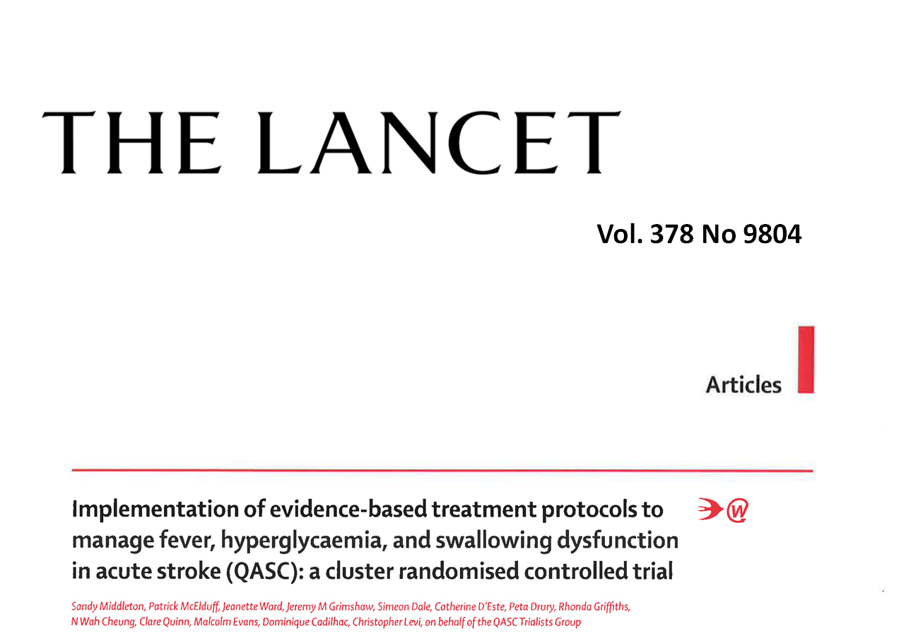
Vol. 378 (9804), 2011
Middleton S, McElduff P, Ward J, Grimshaw JM et al. Implementation of evidence-based treatment protocols to manage fever, hyperglycaemia, and swallowing dysfunction in acute stroke (QASC): a cluster randomised controlled trial. The Lancet 2011; 378(9804): 1699-1706

Slide 9
Background
Clinical guidelines currently recommend early management of the stroke patient in the Emergency Department
TRANSFER
TRIAGE
TREATMENT
Notes:
Add sample size on this slide

Slide 10
Background - Triage
Triage times of < 10 mins (ATS Cat 1 or 2) recommended for patients with stroke signs/ symptoms
  < 13% of stroke patients triaged to Cat 2
  62% triaged to Cat 3 (seen in < 30 mins)
  25% were triaged Cat 4 (seen in < 1 hour)
TRANSFER
TRIAGE
  30% were not allocated an urgent triage category (1 or 2)
TREATMENT
Considine & McGillivray. Journal of Clinical Nursing. 2010, Mosley et al. Australasian Emergency Nursing Journal. 2013
Notes:
Last dot point is data from Ian Mosley:
798 patients were included in the study. Among acute stroke patients who presented within 2 h (n = 185), 173 (94%) were identified as stroke at triage with 10 cases identified as ‘‘altered conscious state’’. In all cases not identified as stroke the patient was diagnosed with intracerebral haemorrhage. 132 cases (71%) were allocated a triage category 1 or 2. Facial weakness (p = 0.002) and presentation to Monash Medical Centre (p = <0.001), were significantly associated with triage category 1 or 2.

Slide 11
Background – Treatment (tPA)
Only 45% of ischaemic stroke patients presenting to hospital within 3 hrs of stroke were assessed for eligibility for rt-PA (2013)
Currently, only 7% of eligible patients in Australia receive thrombolytic therapy
TRANSFER
TRIAGE
TREATMENT
National Stroke Foundation. 2013

Slide 12
Background – Treatment (FeSS)
Fever: 60% received regular monitoring in first 72 hrs of admission
Only 36% with fever (>37.5 C) received paracetamol within 1 hour
Glucose: 21% received regular monitoring in first 72 hrs of admission
Only 25% patients with hyperglycaemia (>10mmol/L), received insulin within 1 hour
TRANSFER
TRIAGE
TREATMENT
National Stroke Foundation. 2013

Slide 13
Background - Treatment (FeSS)
Swallowing: 66% of patients received screen/ assessment within 24 hours of admission
Only 52% received a swallow screen/ assessment prior to oral intake
QASC: 22% given oral fluid or food before screen
QASC: 34% given oral medications
TRANSFER
TRIAGE
TREATMENT
National Stroke Foundation. 2013

Slide 14
Background
QASC trial showed a median ED LOS 7 hrs (max 20 hrs)
ED LOS of 11 hrs (20% >20 hrs)
Median transfer time from ED to stroke unit of 8 hours
TRANSFER
TRIAGE
TREATMENT
Considine & McGillivray. Journal of Clinical Nursing. 2010

Slide 15
Aim
To develop, implement and evaluate the impact on death and dependency, functional dependency and quality of care, of a multidisciplinary organisational intervention to improve the Triage, Treatment and Transfer of stroke patients in Emergency Departments (ED)

Slide 16
Method
Design
Sample Size
  Cluster Randomised Controlled Trial; single blind; allocation concealment; blinded outcome assessment
  Unit of randomisation: EDs
  Unit of analysis: Patients
26 sites in 3 states plus ACT
682 patients pre-Ix
1160 patient post-Ix

Slide 17
Method
  Site eligibility
Patient eligibility
  EDs in ACT, NSW, VIC and QLD hospitals with:
    - a stroke unit
    - deliver thrombolysis
English-speaking
Aged > 18 years
Admitted within 48 hrs of symptom onset
Clinical diagnosis of stroke
Not for palliation
Notes:
Patient eligibility:
EDs in ACT, NSW, VIC and QLD hospitals with:
- a stroke unit
- deliver thrombolysis

Slide 18

Outcome Measures
90-Day Outcome Data
  Computer assisted telephone interview (CATI)
  Death and dependency: modified Rankin Scale (mRS) > 2
  Functional dependency: Barthel Index (BI)
  Health Status: Medical Outcomes Short Form 36 Health Questionnaire (SF-36)

Slide 19
Outcome Measures
Process of Care Data
  Retrospective medical record audit
  ATS category allocation; waiting time
  Assessment of eligibility for tPA and result (eligible/ not eligible)
  Receipt of tPA
  Fever, glucose, swallow screen
  LOS: ED, stroke unit, hospital

Slide 20
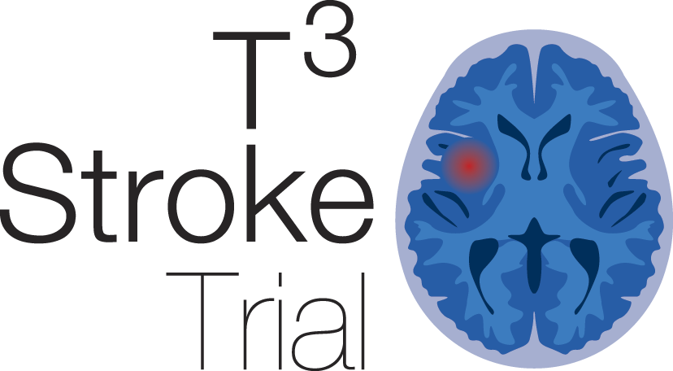
90-day patient
outcome
Processes
of care
Examination
of
contextual factors
Economic
Notes:
Need to say here about the ACT

Slide 21
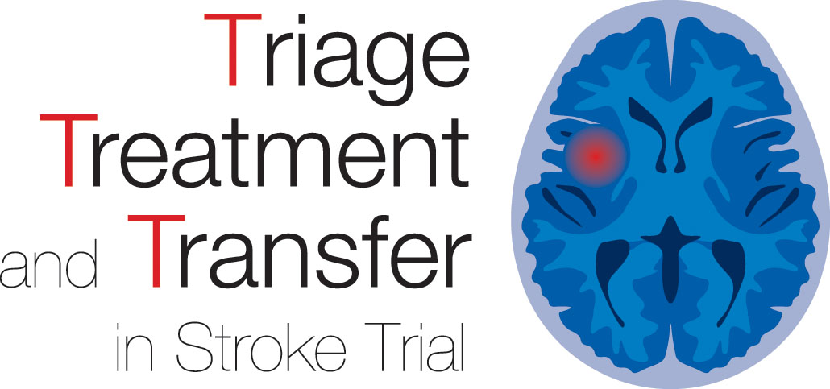
QLD (n=5)
Gold Coast
Nambour General
Townsville
NSW (n=10):
Bankstown
Bathurst Base
John Hunter
Liverpool
Nepean
Prince of Wales
Royal Prince Alfred
St George
St Vincent’s
Westmead
Royal Brisbane and
Women’s
Wesley
ACT (n=1)
Canberra
VIC (n=10):
The Alfred
The Austin
Bendigo Health
Box Hill
Geelong
Royal Melbourne
Wangaratta
Warrnambool Base
Latrobe Regional
St Vincent’s

Slide 22
Intervention
Care Element
  Triage:
  All patients presenting with signs and symptoms of suspected stroke should be triaged at Australian Triage Scale Category 1 or 2 (seen within 10 mins)

Slide 23
Intervention
Care Element
  Treatment: tPA
  All patients to be assessed for tPA eligibility
  All eligible patients receive tPA

Slide 24
Intervention
Care Element
  Treatment: Fever
  All patients to have their temperature taken on arrival to ED and then at least four hourly whilst they remain in ED
  Treat temperature 37.5°C or greater with Panadol within one hour

Slide 25
Intervention
Care Element
  Treatment: Glucose (Sugar)
  Formal venous Blood Glucose Level (BGL) to be sent to laboratory on admission to ED
  Record finger prick BGL on admission and monitor finger prick BGL every 6 hours (or greater if elevated)
  Administer insulin to all patients with BGL > 10 mMol/L within one hour

Slide 26
Intervention
Care Element
  Treatment: Swallowing
  Patients remain NBM until a swallow screen by non- Speech Pathologist (SP) or swallow assessment by SP performed
  No oral food or fluids or meds to be given prior to swallow screen by non-SP or swallow assessment by SP
  All patients who fail the screen are assessed by a SP

Slide 27
Intervention
Care Element
  Transfer:
  All patients with stroke to be discharged from ED within 4 hours
  All patients with stroke to be admitted to the hospital's stroke unit

Slide 28
Intervention
Implementation
  Multidisciplinary Workshops (barrier assessment)
  Identification of site clinical champions
  Implementation plan
  Interactive education
  Reminders:
    Reminder poster/ pocket cards
    Site support (site visits; email and phone support)

Slide 29
Intervention
Barriers: (Triage)
  • ED nurses do not perceive treatment of stroke to be urgent/ a medical emergency
  • A validated stroke screen tool (eg FAST, ROSIER) is not routinely used in the ED to assist in rapid patient assessment
  • ED staff, residents and ambulance staff may be inadequately trained in the recognition of stroke symptoms
  • Patients presenting with resolving symptoms or coordination loss are less likely to be triaged category 1 or 2
  • Lack of stroke leadership to enable a culture of rapid effective stroke care
  • No formal/established hospital protocol (critical pathway) for stroke management including 'Code Stroke' for rapid effective stroke care

Slide 30
Intervention
Barriers: (assessed for tPA eligibility)
  • Physician lack of knowledge/ limited experience with tPA
  • ED non-triage staff have poor recognition of stroke symptoms and have inadequate appreciation of the critical importance of time in the management of acute ischaemic stroke
  • Stressful and overburdened working conditions
  • Lack of staff continuity - staff turnover, leadership changes
  • Lack of tPA protocol
  • Lack of clinical leadership and institutional support for tPA
  • Delays in obtaining CT scans (accessing CT scanner - pt block, distance from ED to CT, reading/interpreting scans)
  • Disagreements between emergency services staff and neurologists regarding benefits of tPA
  • Lack of teamwork

Slide 31
Intervention
Barriers: (eligible patients receive tPA)
  • No point of care testing in ED and/ or delays in laboratory testing
  • Emergency department staff don’t triage stroke as an emergency and therefore not considered time critical
  • Delays - in requesting CT scan, transporting the patient to Radiology, conducting CT scan and reporting scan by radiologist
  • Tasks performed sequentially rather than concurrently lead to delays
  • tPA not stored in ED
  • Lack of appropriately trained staff to monitor tPA patients and manage any complications
  • Difficulties obtaining informed consent (patient/relative) for thrombolysis
  • Out of hours delays due to staffing/resourcing issues

Slide 32
Intervention
Barriers: (Fever monitoring)
  • Managing and organising busy nursing workload
  • Belief that a patient's condition and individual nurse's clinical judgement should determine the frequency of patient observations
  • Lack of fever protocols defining monitoring and treatment for patients with stroke
  • The longer the patient stays in the ED, the longer the interval between vital signs' assessment
  • Patients with less acute (higher triage) category have their vital signs monitored less frequently than patients with a higher acute triage category

Slide 33
Intervention
Barriers: (Fever treatment)
  • Concern for patient safety issues: does administering paracetamol at ≥ 37.5°C mask infection?
  • If patient Nil by mouth (NBM) intravenous (IV) paracetamol is not prescribed due to cost
  • Reluctance of nurses to administer paracetamol per rectum
  • Local protocols restrict nurses to only initiate 1-2 doses of paracetamol

Slide 34
Intervention
Barriers: (Glucose [sugar] monitoring)
  • EENs are not assessed to test BGL
  • Not enough BGL machines

Slide 35
Intervention
Barriers: (Glucose [sugar] treatment)
  • Not enough syringe drivers or pumps
  • Nurse: patient ratio an issue with insulin infusions
  • Patient will require nurse escort to tests if on insulin infusion
  • ED staff fear instigating and managing of hypoglycaemia
  • Lack of consensus about the treatment of hyperglycaemia in stroke
  • Lack of insulin dosage algorithms
  • EENs not able to adjust insulin under their scope of practice

Slide 36
Intervention
Barriers: (Swallow)
  • Doctors reluctant to use formal swallowing screen (i.e. ASSIST tool)
  • Doctors prescribing immediate aspirin when patient ‘Nil by mouth’
  • Nurses administering aspirin before a swallow screen or assessment
  • Clinicians believing 'Nil by Mouth' does not include oral medications
  • Speech pathology staff shortages lead to delay in training nurses in swallow screen
  • Lack of communication between Speech pathologists, doctors and nursing staff
  • Swallow screening will add to nurses' already multiple complex care responsibilities in the ED
  • Lack of standardised swallow screening tools in ED

Slide 37
Intervention
Barriers: (Transfer)
  • Unavailability of inpatient beds in stroke unit
  • Delay in obtaining a porter to transport patient from
  ED to SU
  • Administrative procedures for transferring patients too long
  • Pressure to transfer patients out of ED within 4 hours and if no stroke unit bed available stroke patients go to general wards or medical assessment units

