Slide 1
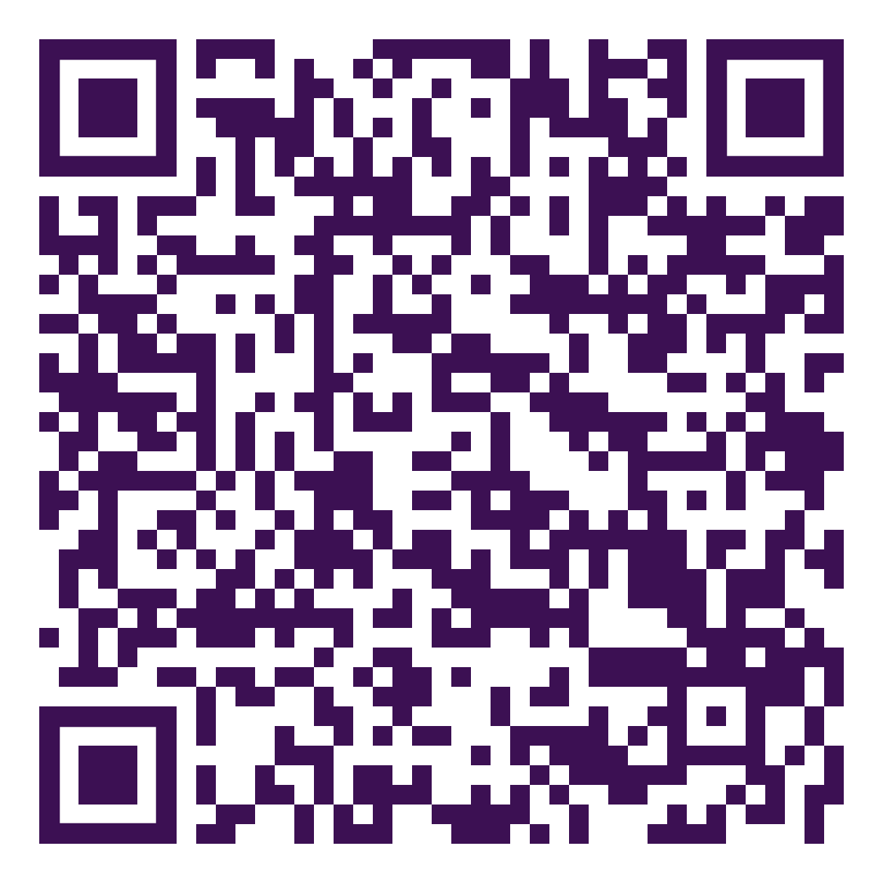
Me, Myself and I: Identity and meaning in the lives of vulnerable young people
This study was conducted by Debbie Noble-Carr, Justin Barker & Morag McArthur (2013)
Background
Identity formation and the search for meaning are fundamental developmental tasks during adolescence. For vulnerable young people — those experiencing trauma, loss, instability and disconnection — these processes are more complex and deeply intertwined. This study explored how such young people understand who they are, what gives their lives meaning, and what support helps them thrive. It recognises that without a secure base of caring connections and belonging, identity and meaning can become fragile and shaped by loss and longing rather than hope and purpose.
Research questions
How do vulnerable young people define and understand who they are?
What gives their lives meaning and purpose?
What supports or constrains positive identity and meaning-making?
How can services and adults better assist young people to strengthen identity, belonging and hope for the future?
Who we engaged
26 young people participated in the study.
These participants were young people aged approximately 15 to 25 years, who had experienced significant adversity, including out-of-home care, homelessness, family breakdown or other forms of marginalisation.
The study also included a Young Person’s Reference Group that guided the research process and a focus group of youth workers, but the 26 young people formed the primary data set for the qualitative interviews.
Key findings
Identity and meaning: Young people actively worked to understand who they were and why they mattered. Their sense of identity was grounded in lived experience, loss and relationships.
Trauma and disconnection: Unstable care and disrupted relationships shaped how young people saw themselves and others, often leading to feelings of invisibility and self-protection.
Rebuilding through values: Many defined themselves in opposition to negative experiences, striving to be caring, respectful and determined.
Forced independence: Without reliable support, young people relied heavily on themselves, which strengthened resilience but deepened isolation.
Pathways to growth: Belonging, recognition and hope fostered positive identity. Key protective elements included caring relationships, opportunities to contribute, community connection and future orientation.
Practice Implications
Provide timely, trauma-informed and sustained support.
Recognise the continuing importance of family in shaping identity.
Build and maintain stable, caring relationships with young people.
Create opportunities for participation and contribution.
Offer holistic, cross-sector support addressing emotional, social and practical needs.
Foster hope and positive future orientation.
“
“No-one’s going to end up supporting you more than yourself.” (25-year-old male)
“What keeps me going is the thought of the future.” (19-year-old male).

